Slide 1
South Korea’s Net Zero Goals on Forestry and Sustainability Issues of Biomass Energy
Biomass International Day of Action
2021 October 21
Soojin Kim
Solutions For Our Climate (SFOC)

Slide 2

Table of Contents
1. Overview: Biomass in renewable energy policy of S. Korea
The use of biomass and subsidies
2. 2050 Net Zero goal for forestry sector and the role of biomass
3. Socio-environmental issues of biomass
Supply chain of imported and domestic biomass sourcing
Sustainability concerns of biomass
3. Concluding remarks
출처: 세계일보

Slide 3
Overview (1) Bioenergy*, second largest source of renewables in S. Korea by electricity generation)
*Bioenergy includes solid, liquid and gasified biofuels. Woody biomass (pellets and woodchips) take up over 80%
Source: Korea Energy Agency (2020)
Notes:
Out of all bioenergy, woody biomass (wood pellets, wood chips, and

Slide 4
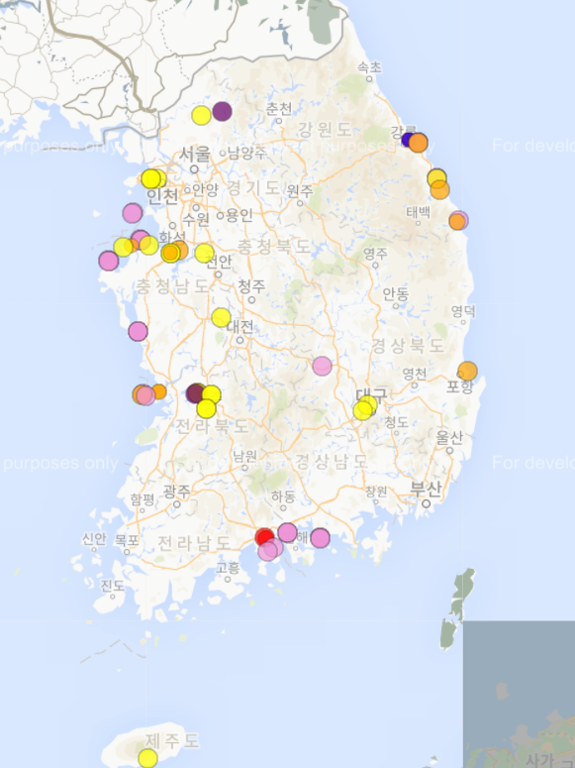
Overview (2) Biomass power generation has been growing 75% annually 2012-2019
Map of biomass power plants in S. Korea
Biomass power plants: 63 operating, 4 under construction
Total installed capacity incl. dedicated and co-fired: 2,000 MW
Total electricity generation from biomass: 7.1 GWh (2019)
Electricity generation from woody biomass* (MWh)
yellow: dedicated
pink: co-fired
orange: pipeline
purple: cogeneration
blue: electricity only
Source: Korea Energy Agency (2020)
*Woody biomass includes wood pellets, woodchips, and bio-SRFs
Source: EPN, 2021

Slide 5
Overview (3) Biomass subsidies in S. Korea
Duplicate subsidies from both energy and forestry sector have been given to biomass, and the scale of government support exceed that of other renewables such as solar and wind power
Energy sector subsidies
Forestry sector subsidies
Biomass was the largest source of renewables by Renewable Energy Credit (REC) issuance and RPS Implementation Compliance Fee in 2012-2018
Wood pellet and wood chips are eligible for REC weightings of 0.5 – 2.0. In some cases, domestic pellets received 3 times greater than large scale solar PVs.
Coal power plants nearing-to-retire eligible for subsidies to retrofit and replace fuel to biomass
Subsidies for reforestation after clear cutting has incentivized unsustainable logging (government pays 90%)
Subsidies for reforestation for biomass on the Economic Forest Development Complex (government pays 60%)
Distribution of wood pellet boilers for households (government pays 70%)
In addition, several related subsidies are given in cash including: un-utilized forest resource center (70%), forest biomass energy village (100%), and seedling production for reforestation (70%)

Slide 6
2050 Net Zero Implementation Strategies for forestry sector and the role of forest biomass

Slide 7
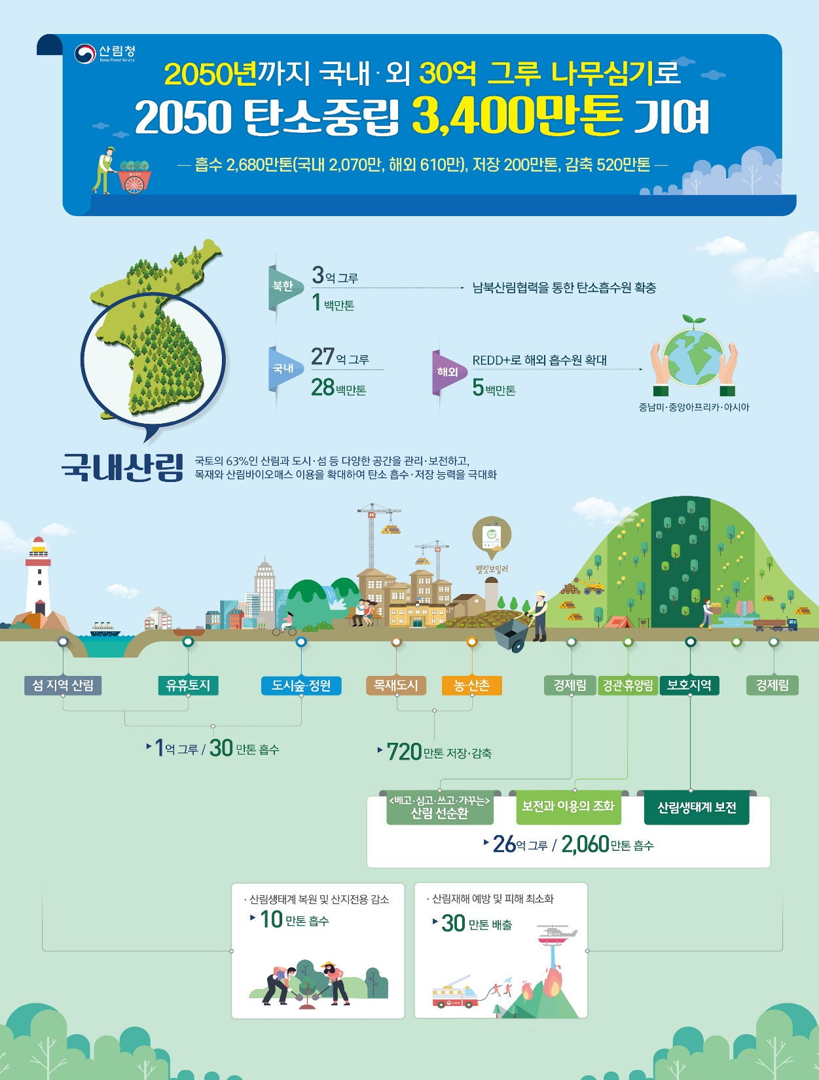
Forest Sector Net Zero Goal: Replanting 3 billion trees by 2050
Plans to log 3 billion trees that are older than 30 years and replace them with younger trees
→ 26.3 million tons of net CO2 sequestration by 2050 from forests
→ Out of 26.3 million tCO2eq., 20 million tons come from harvesting 3 billion older trees
This number includes 3.1 million tons of CO2 emission reduction from biomass replacing fossil fuels
→ double counting (forestry vs. energy sector)
Source: Korea Forest Service

Slide 8
Sustainability Concerns of Forestry Sector Net Zero Goals
(1) Reforestation vs. Afforestation
Of the 2.7 billion trees planted in S. Korea, only 100 million are newly planted in island areas and idle land
Since 2018, 29 million trees have been planted annually in the Economic Forest Development Complex.
To plant 2.6 billion trees, 86 million trees must be planted annually by 2050 (more than 3 times of a volume to be increased by 2050); and requires 900,000 hectares
(2) Principle of cascading use of wood does not exist.
Use of domestic wood is focused on short term cycle (short half life of carbon and low value products) such as biomass
Sawn wood only consists of 13%, and the rests are considered low value use such as pulp (25%), MDFs (27.5%), biomass (12.5%), and others (20%)

Slide 9
Sustainability Concerns of Forestry Sector Net Zero Goals (continued)
(3) Incompleteness of forest carbon statistics and uncertainties on projections for forest carbon sequestration
S. Korea’s forest carbon inventory does not include below ground biomass and its national forest statistics has data uncertainty issues
Projections on carbon sequestration based on even-aged single species forests – lack of considerations on multi-species and variable age forest stands
Lacked data from long-term ecological monitoring sites on carbon sequestration and other ecological services of forests

Slide 10
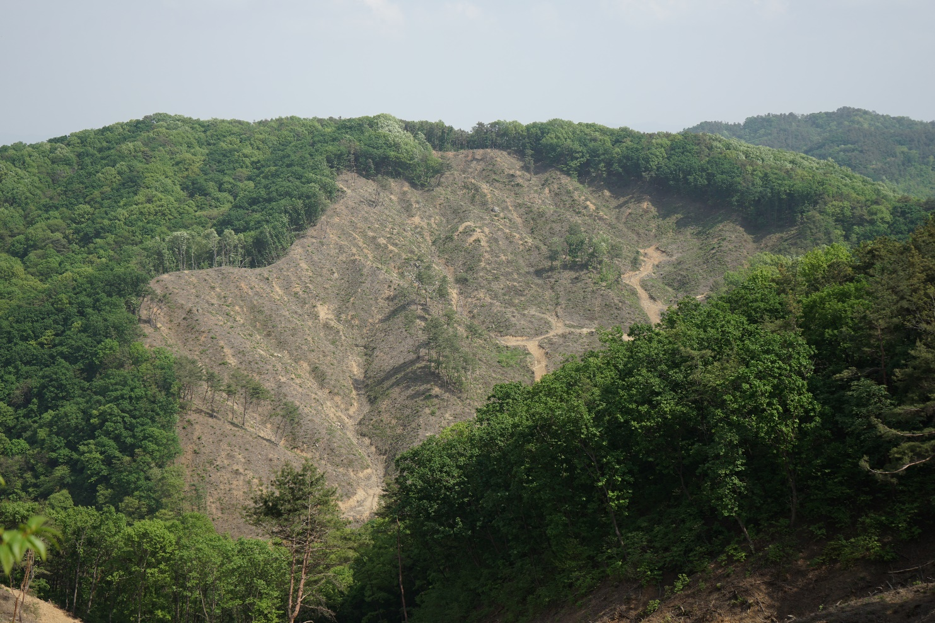
Environmental and social concerns on biomass sourcing in South Korea
@기후솔루션, 환경운동연합 2021

Slide 11
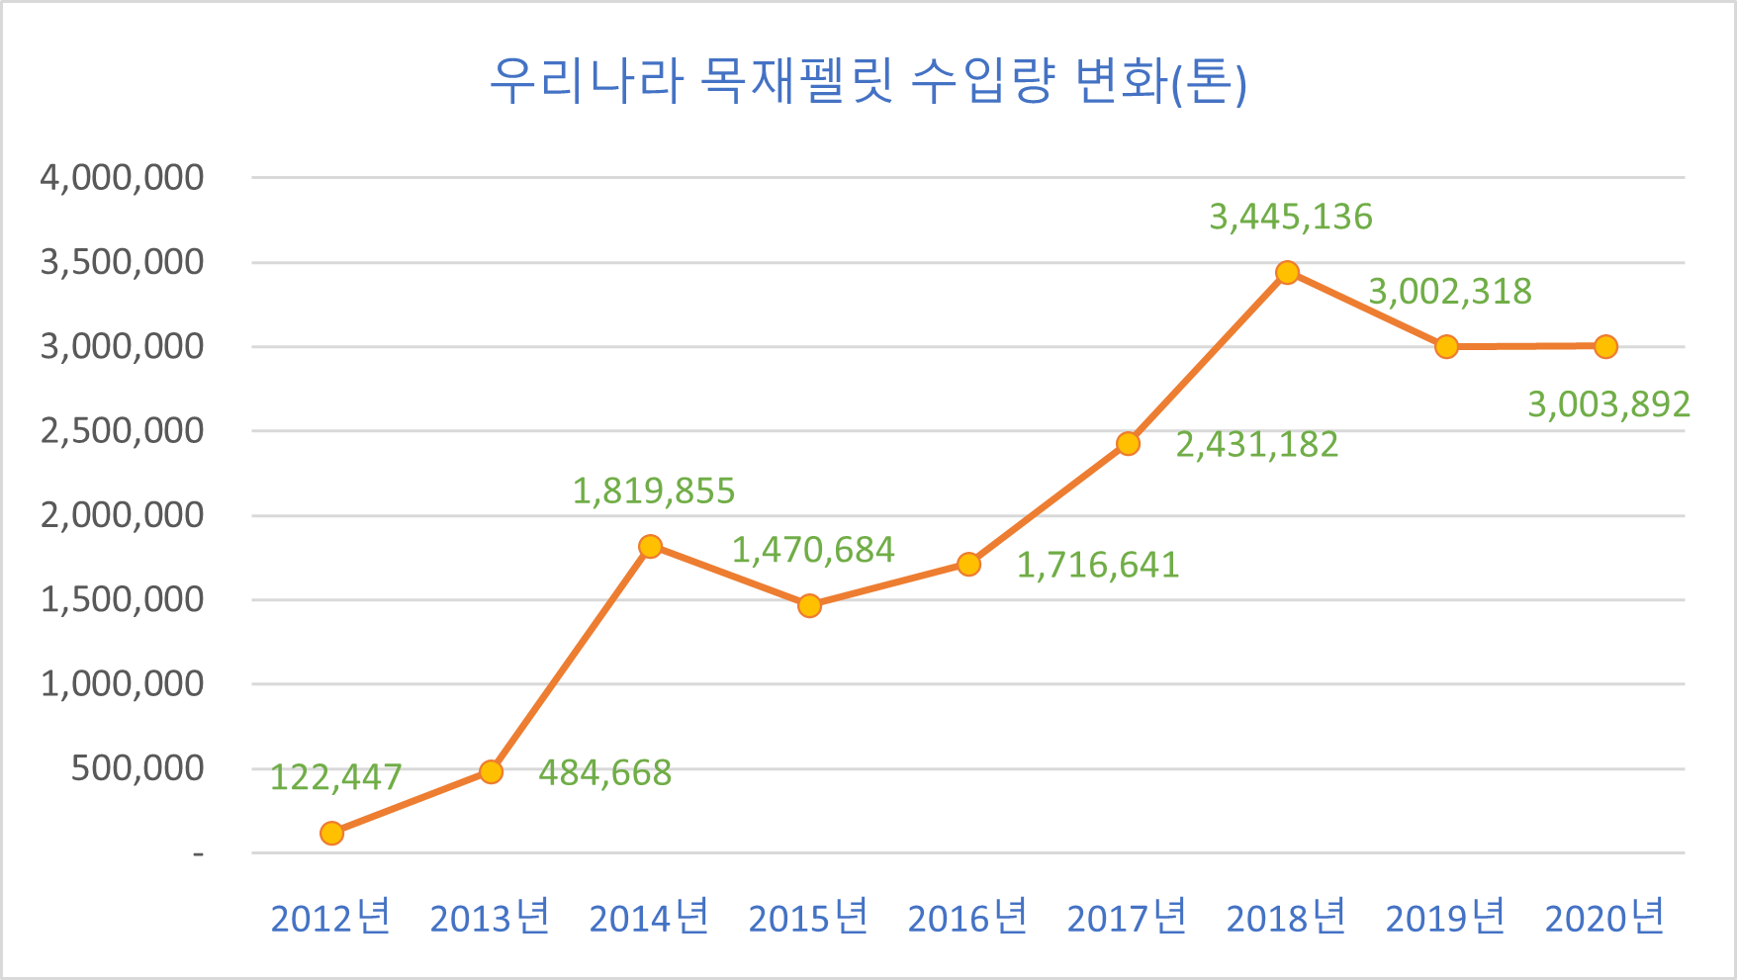
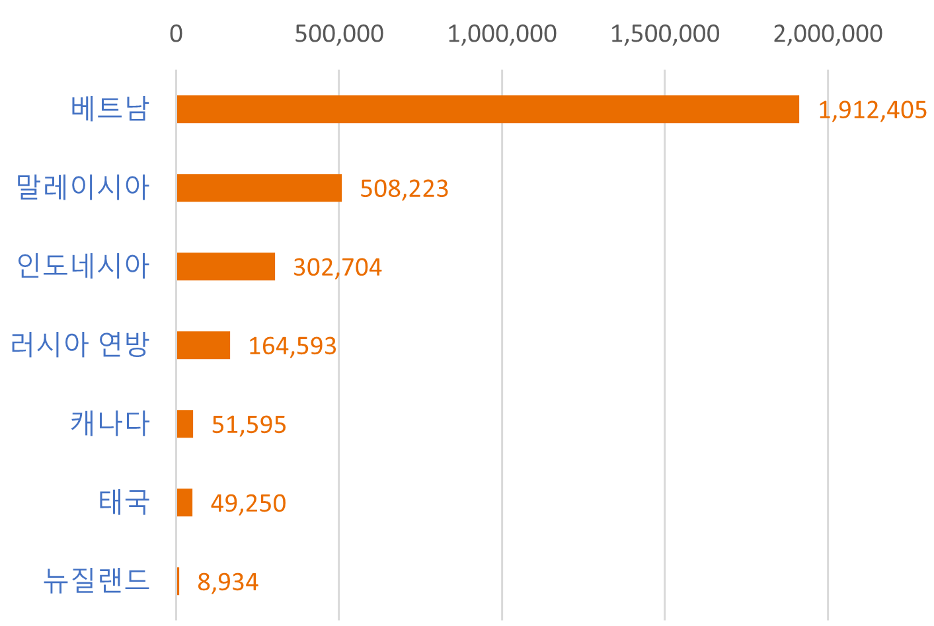
S. Korea’s biomass sourcing (overseas): high dependency on pellets originated from South-East Asia, Russia and Canada
S. Korea imports more than 3 million tons of wood pellets, sourced from South-East Asia (Vietnam), Russian federation and Canada.)
Annual wood pellet imports (ton)
Vietnam
Malaysia
Indonesia
Russia
Canada
Thailand
New Zealand
Source: S. Korea Customs Office (2021)

Slide 12
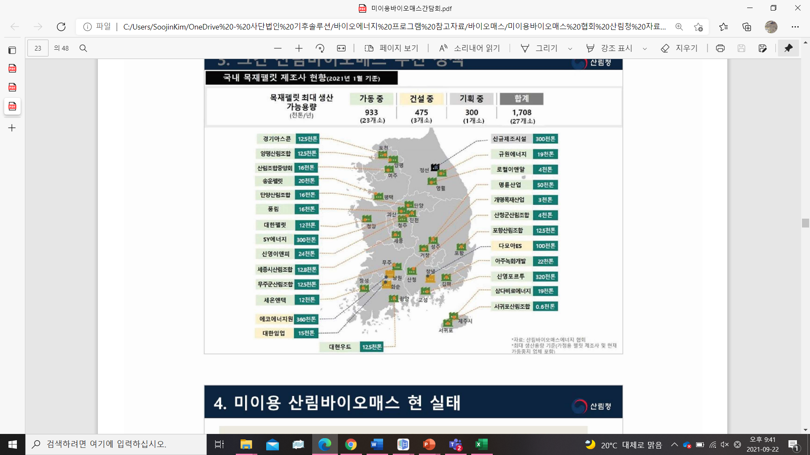
S. Korea’s biomass sourcing (domestic): a rapid increase due to increased logging and policy incentives
Domestic wood pellet production and investments increased since 2018 due to new REC weightings for domestic un-utilized biomass combined with increased logging.
Source: National Institute for Forest Science (NIFOS) (ton)
Source: Korea Forest Service

Slide 13
Sustainability concerns regarding biomass (1)
Air pollution and CO2 emissions from biomass are significant, and local residents are opposing construction plans of biomass power plants.
Air pollution and CO2 emissions from biomass per unit of energy is greater than that of coal, proved by empirical and field data
Source: KOEN and National Assembly Women Soyoung Lee, 2020
1)
1) The original number reported by KOEN for CO2 emissions from biomass was 0.026 kg/MWh (excludes CO2 from burning biomass). When the CO2 emissions from burning are added, we get 0.886 kg/MWh, with an assumption that the wood pellets used are bone dry (10% or less moisture contents).

Slide 14
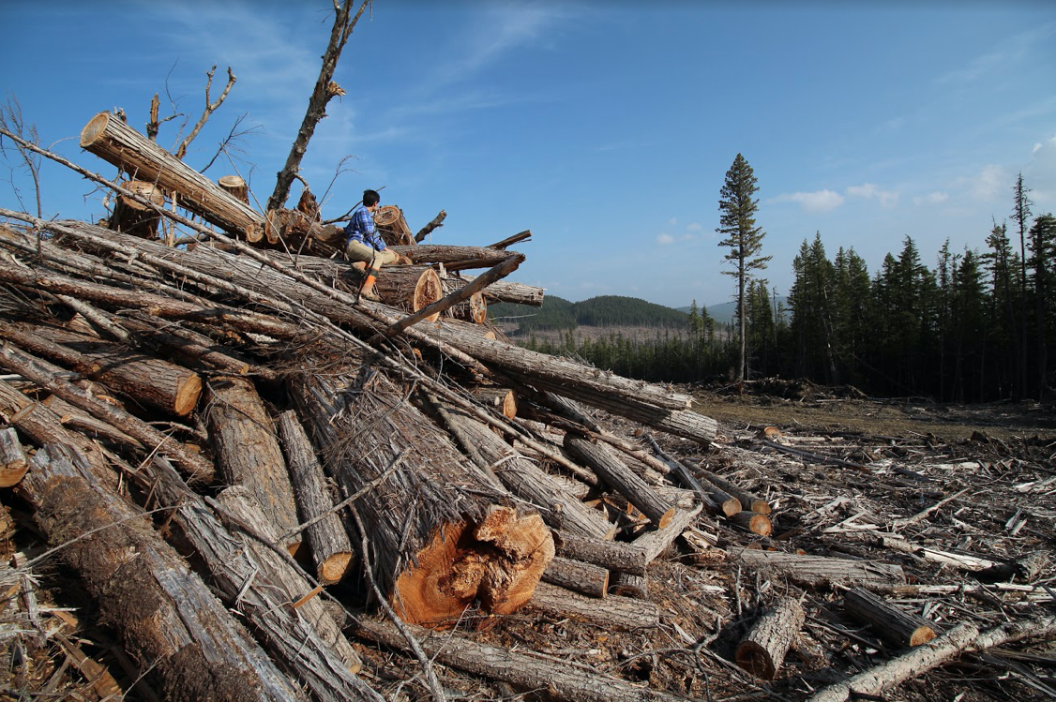
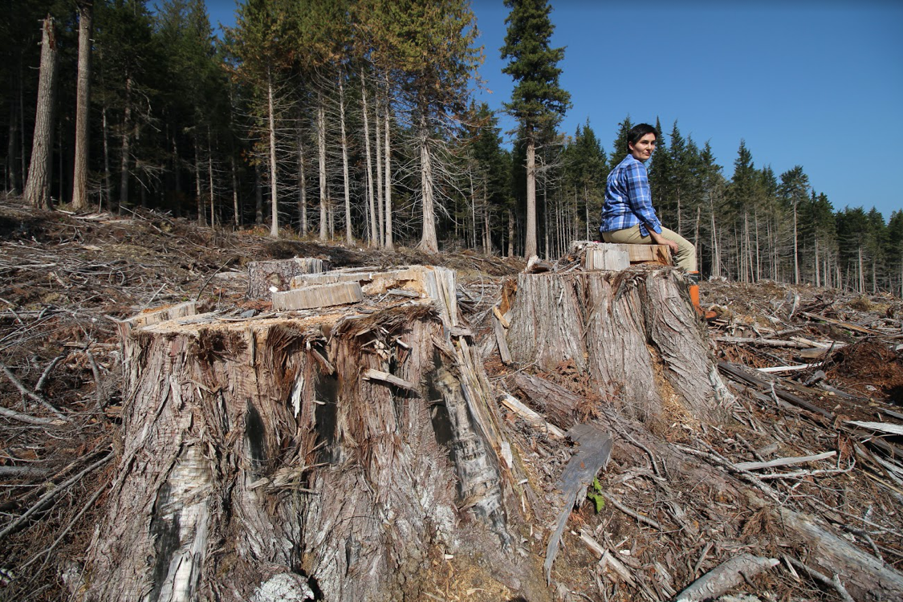
Sustainability concerns regarding biomass (2)
No sustainability certification is required for imported biomass
Only legal wood harvesting permit is required for importing biomass to S. Korea.
Falsified documents have been found at customs office.
Photo credit: Conservation North

Slide 15
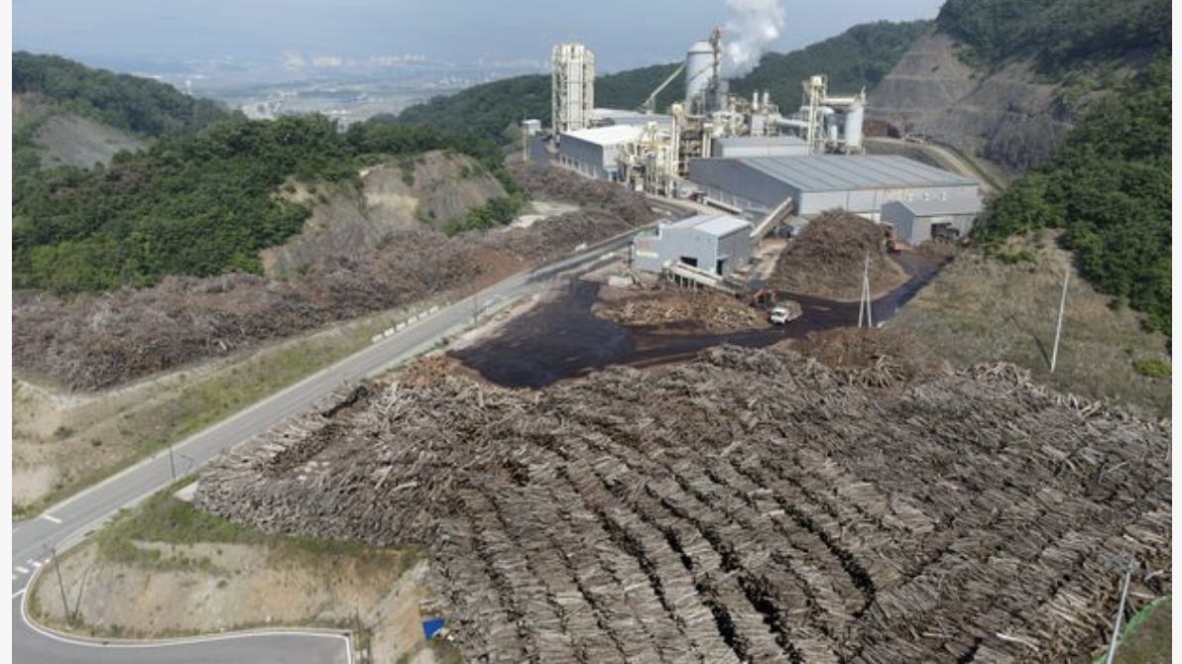
Sustainability concerns regarding biomass (3)
Domestic pellets are sourced from unsustainable practices and there are problems with RECs issuance processes
No sustainability requirements for domestic wood pellet sourcing
  Environmental impact assessment is not applied to large scale logging.
  Problems with definition of un-utilized biomass and its verification process for RECs issuance make this sector vulnerable to criminal activities
  Korea Forest Service has no authority or legal ground to penalize those who violated the system.
  Consequently, most biomass is sourced from clear cutting and disqualified fuels have received RECs.
Source: Chosun Ilbo, 2021

Slide 16
Concluding remarks
Immediately remove RECs from large scale biomass, cancel existing construction plans, and revise REC schedule based on size of utility (and the utilization of heat).
Urgent need to ban sourcing of biomass from large scale logging, especially through clear cutting.
Need a basis for understanding greenhouse gas emissions of biomass throughout its lifecycle (LCA study).
Need to introduce sustainability criteria and enhanced requirements on sourcing and no-go zones.
Require a volume cap for biomass in energy mix and set a phase out date.
Close collaboration with importing countries in South-East Asia for research and advocacy required.
Solidarity with local communities and environmental groups on planned biomass constructions.

