Slide 1
The Current State of Japan's FIT System and the Problems with Imported Biomass Power Generation
Briefing for International Media
October 21, 2021
President, Biomass Industrial Society Network (BIN)
Miyuki Tomari

Slide 2
Overview of Biomass Utilization and Forestry in Japan
Primary industries have lacked international competitiveness and have been pushed aside by imports.
For many years, forestry has relied on subsidies.
From around 2000, biomass began to receive policy support as a renewable energy source, but growth has been sluggish with few exceptions.
The purpose of FIT system, which started in 2012, was to utilize forest scraps of forest land in Japan.. However, in order to add to the amount of renewable energy introduced, the scheme also promotes power generation using imported biomass.
Many foreign companies are also involved in large-scale imported biomass power generation projects.

Slide 3
Feed-in Tariff Scheme for Renewable Energy (FIT)
A scheme to promote renewable energy sources, such as solar, wind, and biomass.
Objectives: Reduce environmental load, strengthen Japan's international competitiveness and promote industries, and revitalize local communities.
Began in July 2012.
Renewable energy power is purchased at a high price to increase power generation projects.
Electricity users (Japanese citizens) bear the cost of purchasing electricity at high price.
Helped to increase electricity from renewable energy sources, but there are problems with the scheme design (purchase price was too high, etc.) → the system went through many changes and improvements
Transition to FIP system in 2022

Slide 4
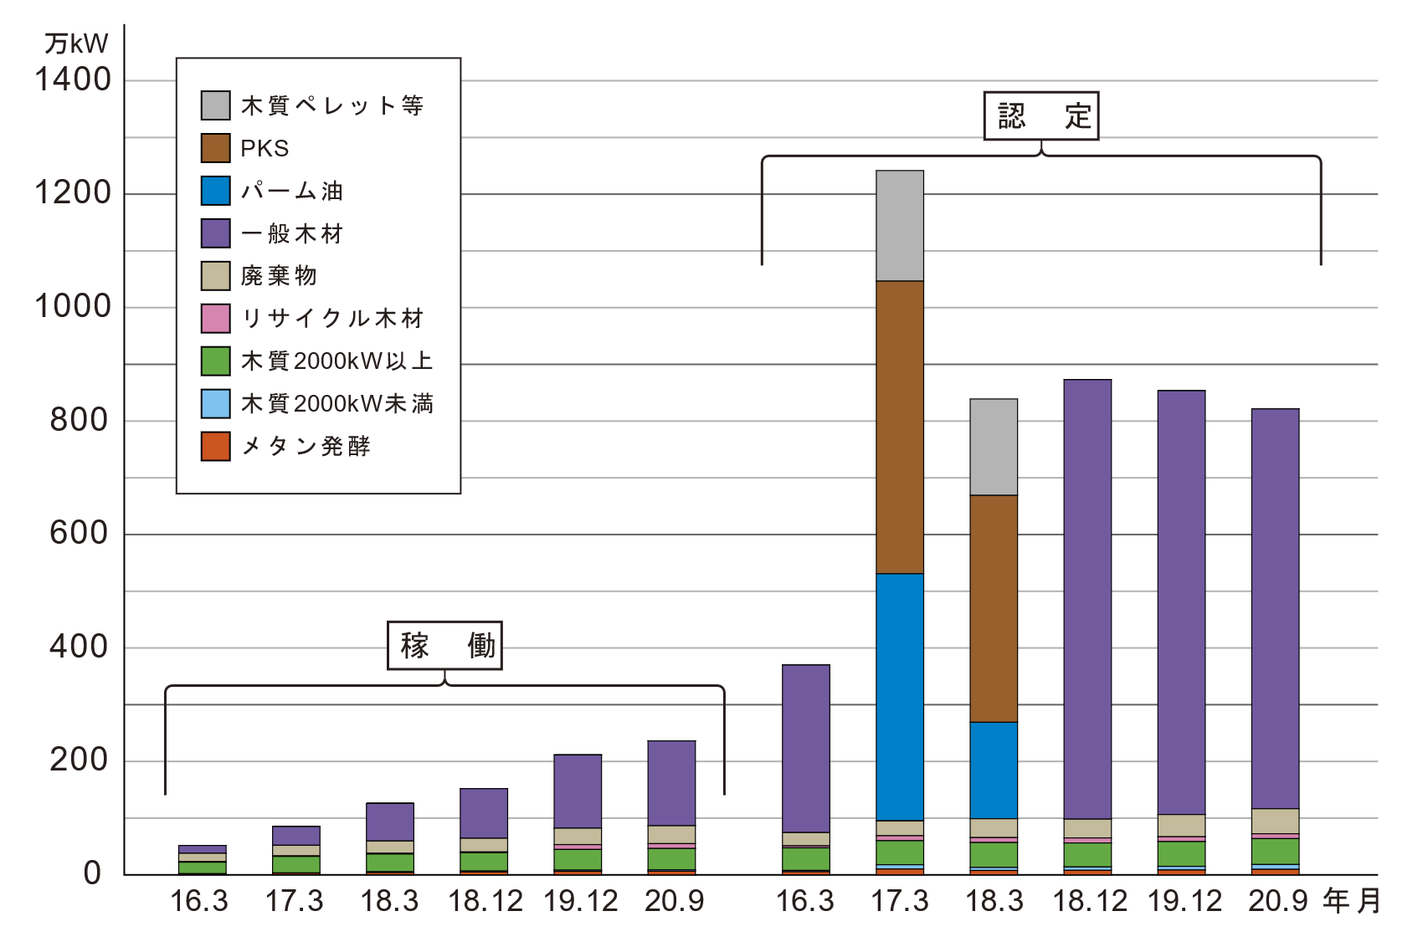
Table 1: Operation and certification status of biomass power generation under the Feed-in Tariff scheme for renewable energy (FIT) (New, as of the end of September, 2020)
Methane
fermentation
Unused wood
General
wood
Recycled wood
Waste
Total
Less than 2000kW | 2000kW or more
Number of cases in operation
Number of certified cases
Operating capacity (kW)
Certified capacity (kW)
Source: Agency for Natural Resources and Energy (ANRE) website*2
(In 10,000 kW)
Certified
Woody pellets, etc.
PKS
Palm oil
General wood
Waste
Recycled wood
Wood less than 2000kW
Wood 2000kW or more
Methane fermentation
Mainly imported fuel
In operation
YY.MM
Notes:
FITのバイオマス発電の状況です。グラフ左半分が稼働した事業、右半分が認定された事業です。認定されたバイオマス発電のうち９割が、輸入バイオマスを主な燃料とする区分です。
This is the status of biomass power generation under FIT. The left half of the graph shows projects in operation, and the right half shows projects that have been certified. 90% of the certified biomass power generation projects are classified as using imported biomass as the main fuel.

Slide 5
Current problems with biomass power generation under FIT
90% of the certified capacity is general woody biomass, mainly fueled by imported biomass
Fuels with sustainability issues such as palm oil and whole wood pellets are also used.
Life-cycle greenhouse gas (GHG) was not taken into account. (Currently being considered by the METI’s Biomass Sustainability Working Group)
Imported biomass does not lead to Japan’s energy self-sufficiency, has limited benefits for local communities, and tends to have higher life-cycle GHG emissions.
Imported biomass power generation under the FIT system is expected to cost the Japanese people more than 8 trillion yen over 20 years.
Although the number of new projects is not expected to increase much, the question is what to do with the existing certified projects of 7M kW or more.

Slide 6
(In 10,000 tons)
Pellet (left)
PKS (right)
Canada
Vietnam
Others
Indonesia
Malaysia
Figure 2. Changes in import volume of PKS and woody pellets
Source: Prepared by Biomass Industrial Society Network (BIN) based on On-site Report No. 454 and 455, etc.
*Imports from U.S. are expected to increase rapidly in the future.
Notes:
FIT開始以後、木質ペレット、PKS（Palm Kernel Shell）の輸入が激増、2020年には合計500万トンを超える。2021年はさらに増加する見込み。
Since the start of FIT, imports of woody pellets and PKS (Palm Kernel Shell) have increased dramatically, and exceeded a total of 5 million tons in 2020. They are expected to increase further in 2021.

Slide 7
Long-Term Supply Contract of Enviva, Inc., a U.S. Wood Pellet Company
Other Japanese companies
Toyota Tsusho
Szukawa
Sumimoto Forestry
Sumimoto
Ichiahara
Marubeni Corporation
Mitsubishi
6.9M tons/year
Figure: Enviva's 2025 long-term supply plan*8
Notes:
これまで英国等へ木質ペレットを輸出していた米国のエンビバ社は、今後、半分以上350万トン以上を日本に輸出する見込み
The U.S. company Enviva has been exporting wood pellets to the U.K. and other countries. In the future, the company is expected to export more than 3.5 million tons, which is more than half of its total exports, to Japan.

Slide 8
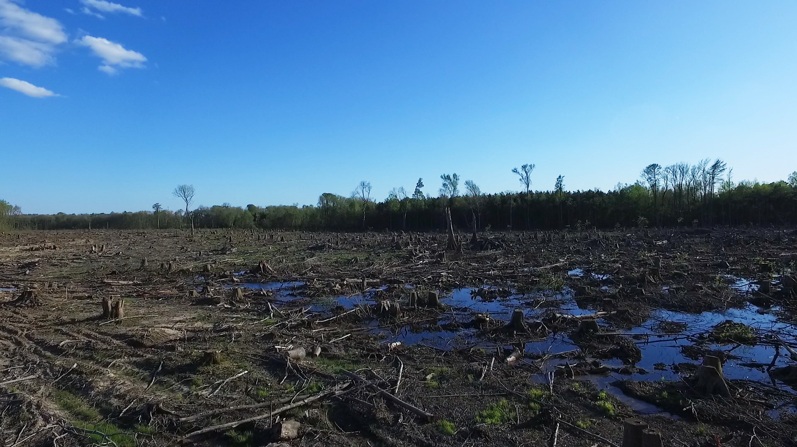
Wetland forest after being harvested as raw materials for wood pellets in North Carolina, U.S.
Photo: Marlboro Productions
Source: Materials by Mary Booth, International Seminar: Questioning the Sustainability of Forest Biomass - Proposals for Imported Woody Fuels and FIT System
Notes:
エンビバ社のペレット原料として伐採された湿地林（自然林）。
用材に向かなかったため残されていたが、ペレット向けとすることは可能なため、伐採された。生物多様性に富み、洪水防止機能もあったとのことです。
Wetland forest (natural forest) that was cut down by Enviva for raw materials for wood pellets.
The forest was left because it was not suitable for lumber, but was cut down because it could be used for pellets. The forest was rich in biodiversity and served a flood prevention function.

Slide 9
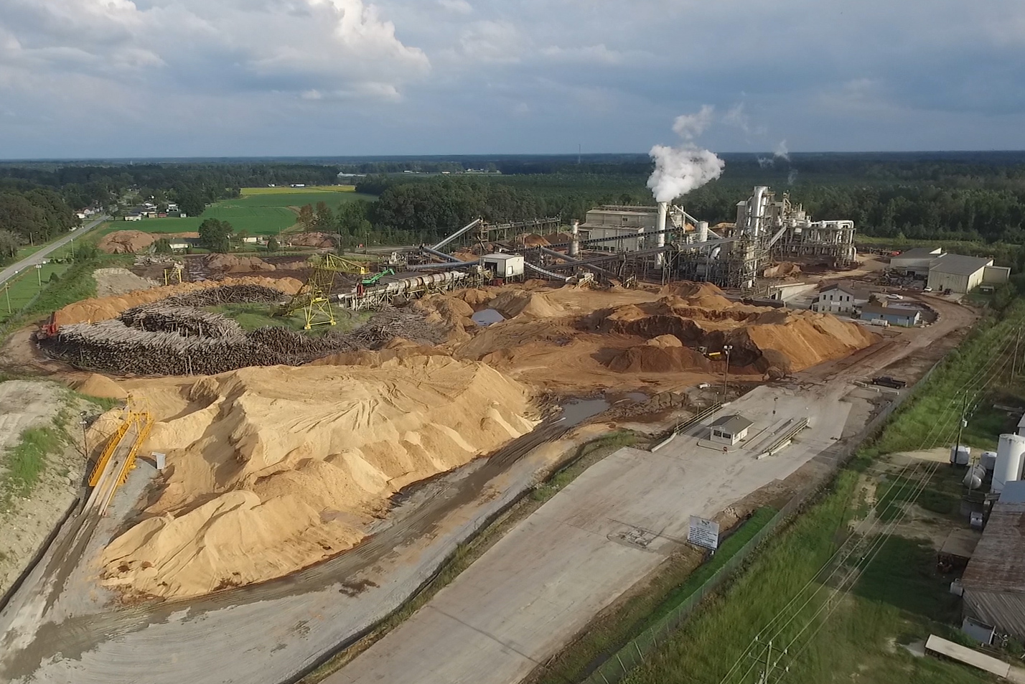
Enviva's pellet plant in Ahoskie, North Carolina
Photo: Marlboro Productions; source: same as above
Notes:
大規模なエンビバ社のペレット工場
Enviva’s large-scale pellet plant

Slide 10
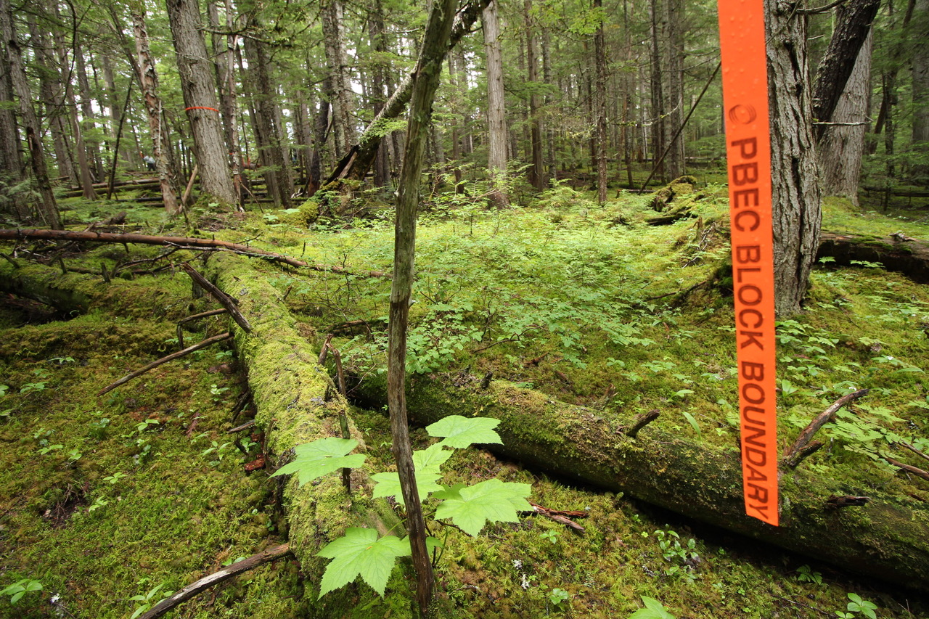
Logging permission for this primary forest area has been granted to a pellet company (Photo: Conservation North)
Notes:
カナダ州政府よりペレット会社に伐採が許可された原生林。
Canadian provincial government gave a permission to a pellet company to log this primary forest.

Slide 11
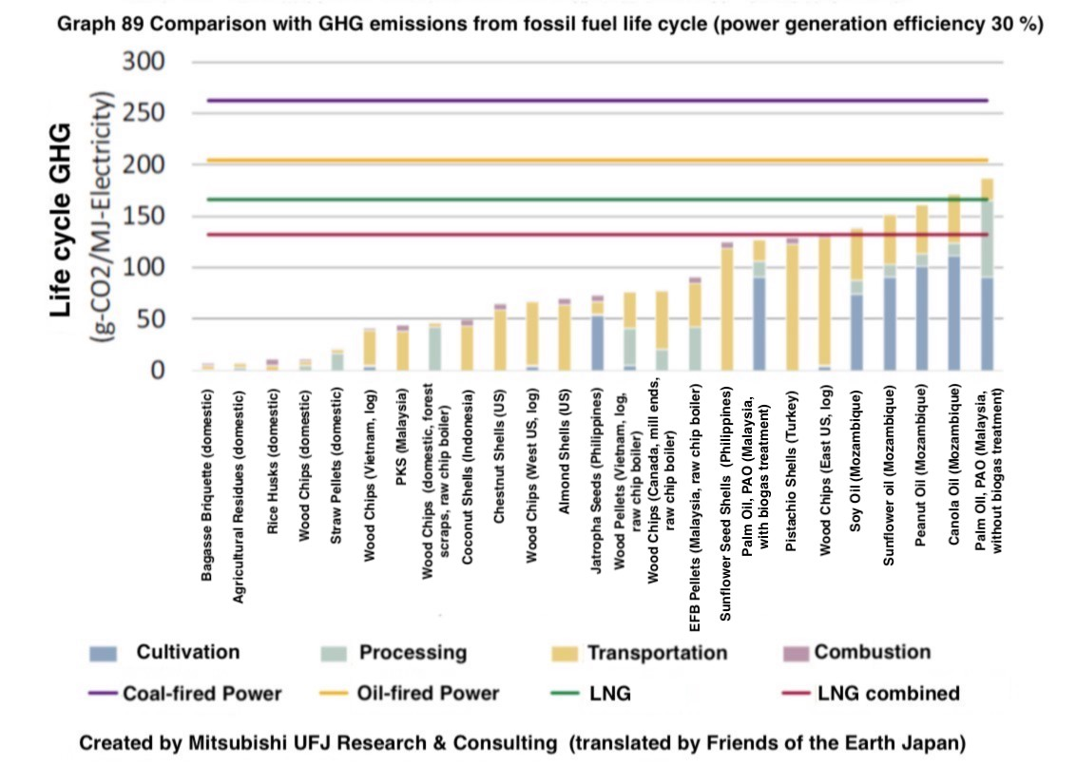
Proposals for GHG Standards for FIT Biomass Power Generation
Source: Column (1), Biomass White Paper 2021
https://www.npobin.net/hakusho/2021/topix_01.html#column01
Sustainable Development Scenario (SDS): The value per unit of electricity that the world will need to achieve by 2040 to meet the goals of the Paris Agreement, presented by the International Energy Agency (IEA). In this figure, only domestic forest scraps, etc., meets the SDS value.
Notes:
このグラフは、さまざまなバイオマス燃料による電力の温室効果ガス排出量です。
栽培、加工、輸送にかかる化石燃料の使用などによる温室効果ガス排出量は、天然ガスよりも多いものもある。バイオマスの持続可能性基準の国際的な傾向では、化石燃料の50％未満は最低ラインだが、（水色のライン）多くの輸入バイオマスがこれより多い。
This graph shows the volume of GHG emissions from electricity generated by various biomass fuels.
Some GHG emissions, such as those from the use of fossil fuels for cultivation, processing, and transportation, are greater than those from natural gas. According to the international trend of sustainability criteria for biomass, less than 50% of fossil fuel (light blue line) is the minimum line. However, many imported biomasses exceeds this line.

Slide 12
Overview of the Biomass Industrial Society Network (BIN)
Established in 1999 (incorporated as an NPO in 2004)
Conducts awareness-raising and other activities to promote the sustainable use of biomass
Holds study meetings once a month
Prepares biomass white papers (online and booklet versions)
http://www.npobin.net/hakusho/2021/
Mailing lists and mail magazines
Conducts researches, and provides recommendations and advice on biomass
Secretariat
3-15-12 Shinokidai, Kashiwa, Chiba 277-0945 Japan
Tel: 047-389-1552 Fax:047-389-1552
E-mail:mail@npobin.net http://www.npobin.net
Notes:
NPO法人バイオマス産業社会ネットワークは、持続可能なバイオマス利用推進に取り組んでいます。
バイオマス白書などを出しています。詳しくはWebサイトを見ていただければ幸いです。
The Biomass Industrial Society Network is working to promote sustainable biomass use.
We publish biomass white papers and other resources. Please visit our website for more information,

